Slide 1
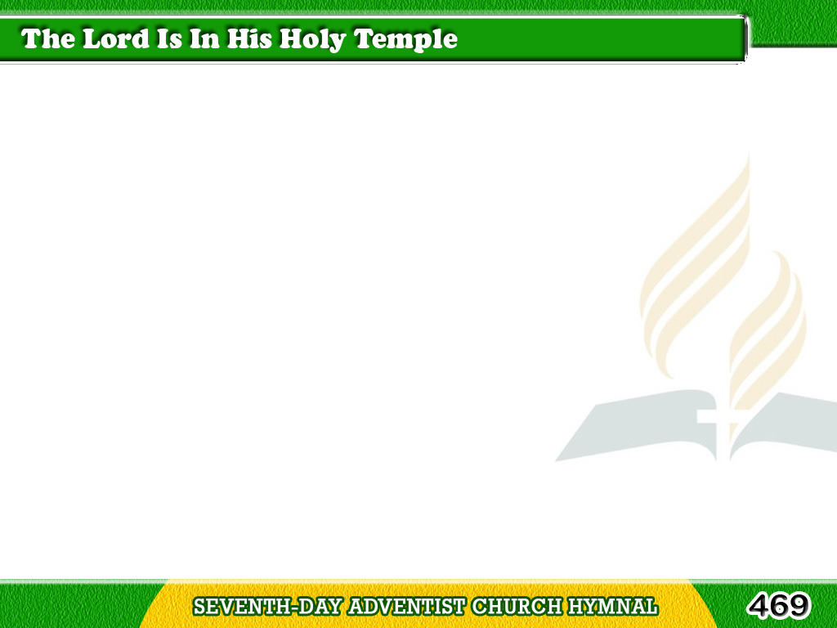
1/1
The Lord is in His holy temple,
The Lord is in His holy temple,
Let all the earth keep silence,
Tagalog
Version

Slide 2
1/1
Let all the earth
keep silence before Him,
Keep silence,
Keep silence before Him. Amen.
Tagalog
Version

